Slide 1
CLASS MODELS IN UML

Slide 2
INTRODUCTION
The class diagram shows the building blocks of any object-oriented system
The potential for collaboration among those classes, through message passing, is shown in the relationships between these classes
A class diagram shows a static view of the classes in a model, or part of a model
The attributes and operations of classes are shown along with the various different kinds of relationship that bind the classes together

Slide 3
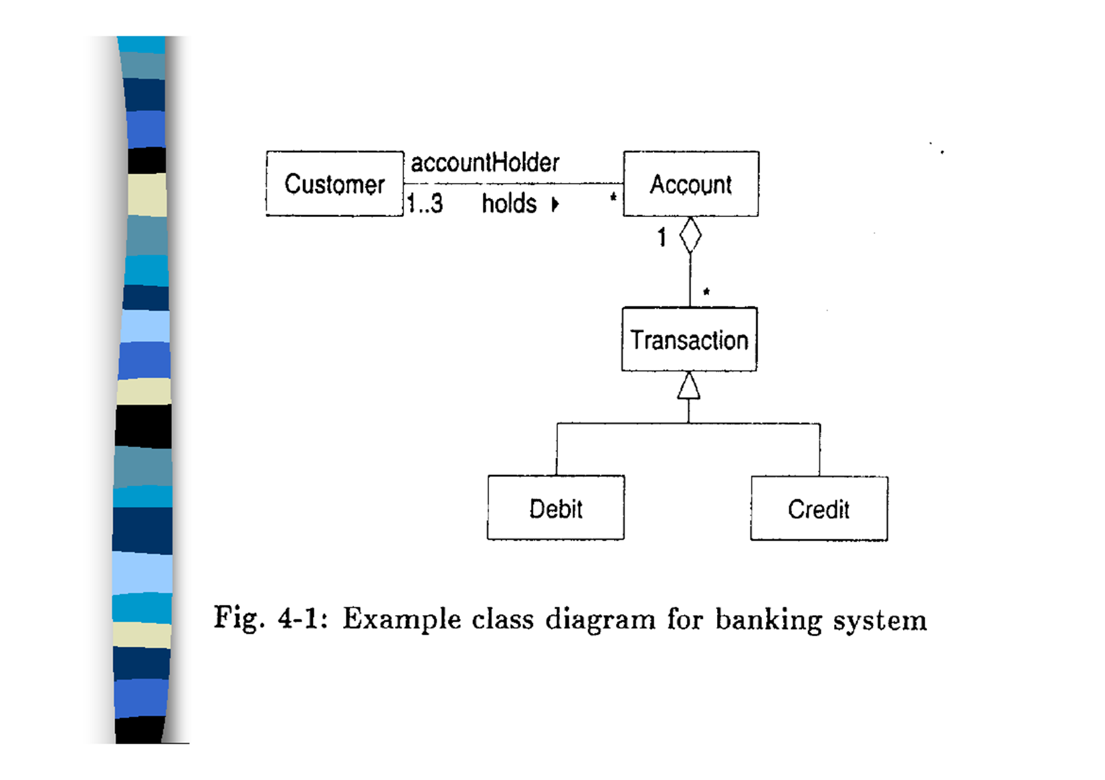

Slide 4
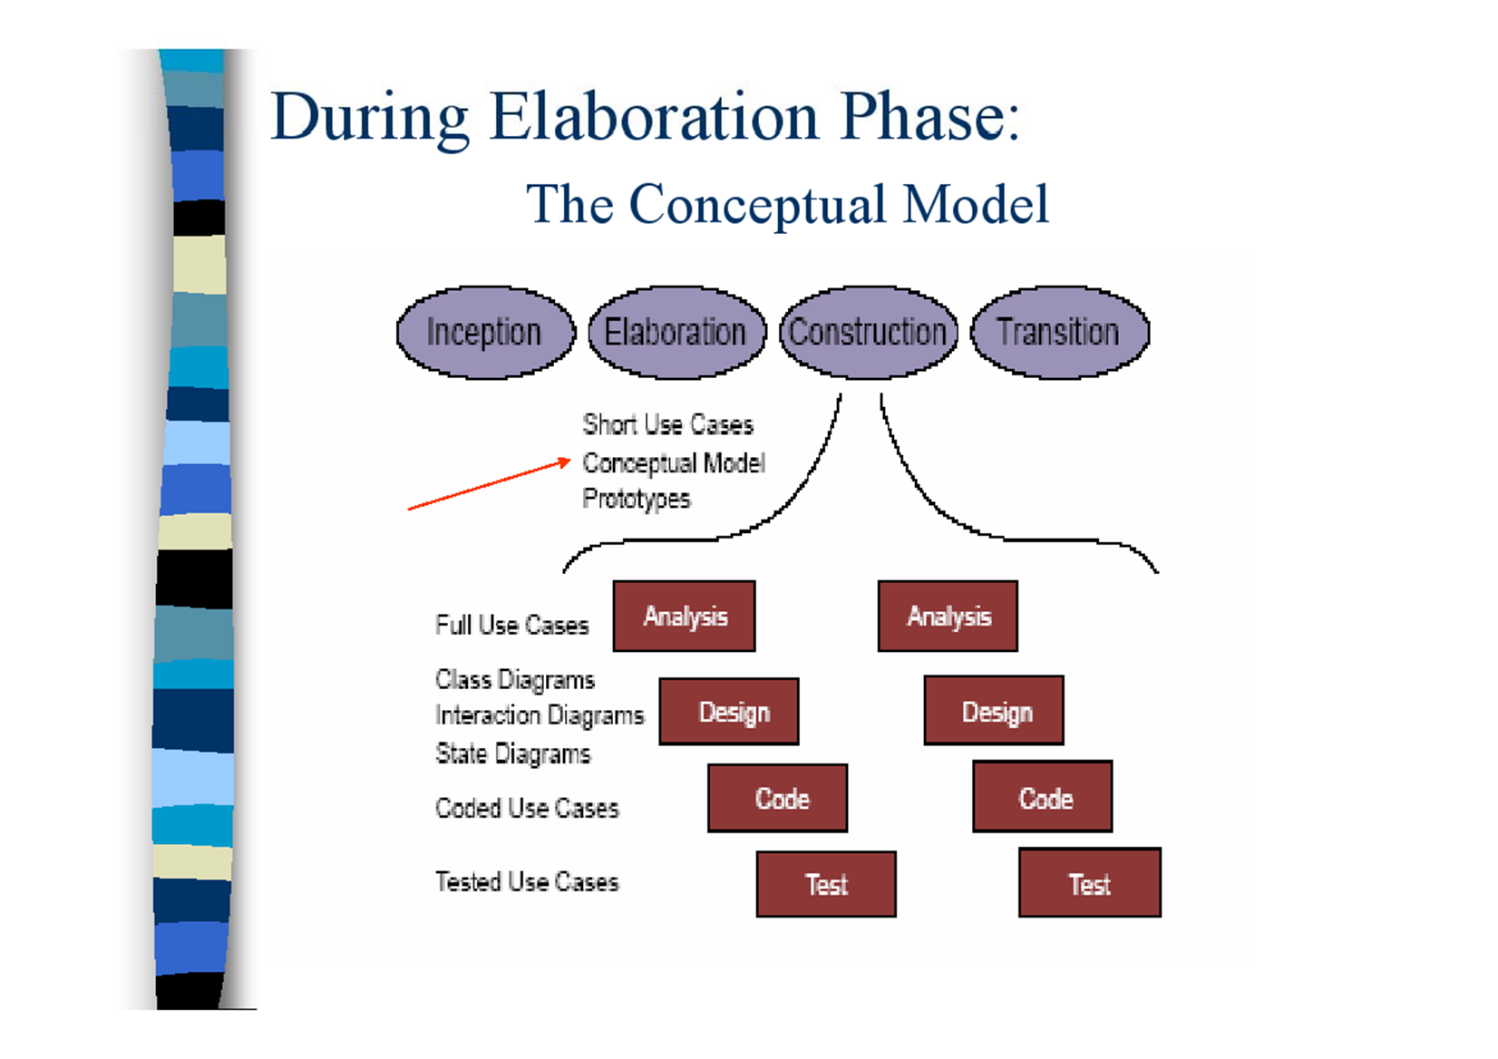
During Elaboration Phase:

Slide 5
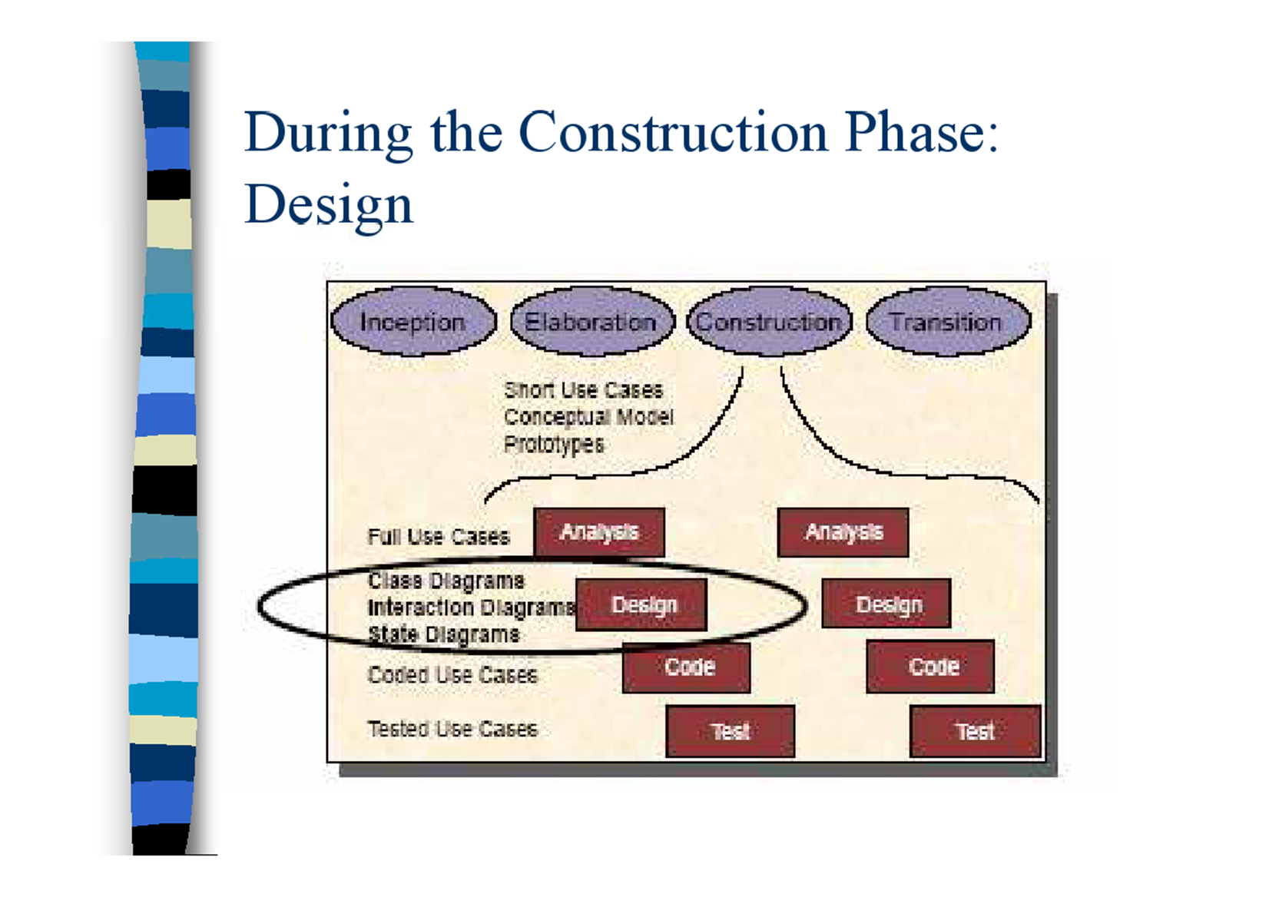
During the Construction Phase: Design

Slide 6
Modeling Approaches Using Classes
Conceptual Modeling
A model (or diagram) produced from a conceptual perspective will consist both of classes apparent to the problem domain and of classes that represent insights into that problem domain
Functional Delegation
- Models and diagrams produced from a specification or implementation perspective will reflect the intended design or implementation, respectively, of a software system

Slide 7
Functional Delegation
The principle of functional delegation is that responsibility for data ownership and processing of that data should be delegated to the most appropriate class
Given that interactions between classes are being modeled, this implies that three primary components of class models can be investigated using this modeling approach:
Classes
Operations
Associations

Slide 8
CRC-Card Technique
The most popular technique for simulating the collaboration between classes is the Class-Responsibility-Collaboration (CRC) card technique
A CRC card is a small piece of card or paper
The name of a class is written at the top of the card
Down the left hand side of the card, the responsibilities of the class are listed.
Down the right hand side the other classes with which this class collaborates are listed

Slide 9
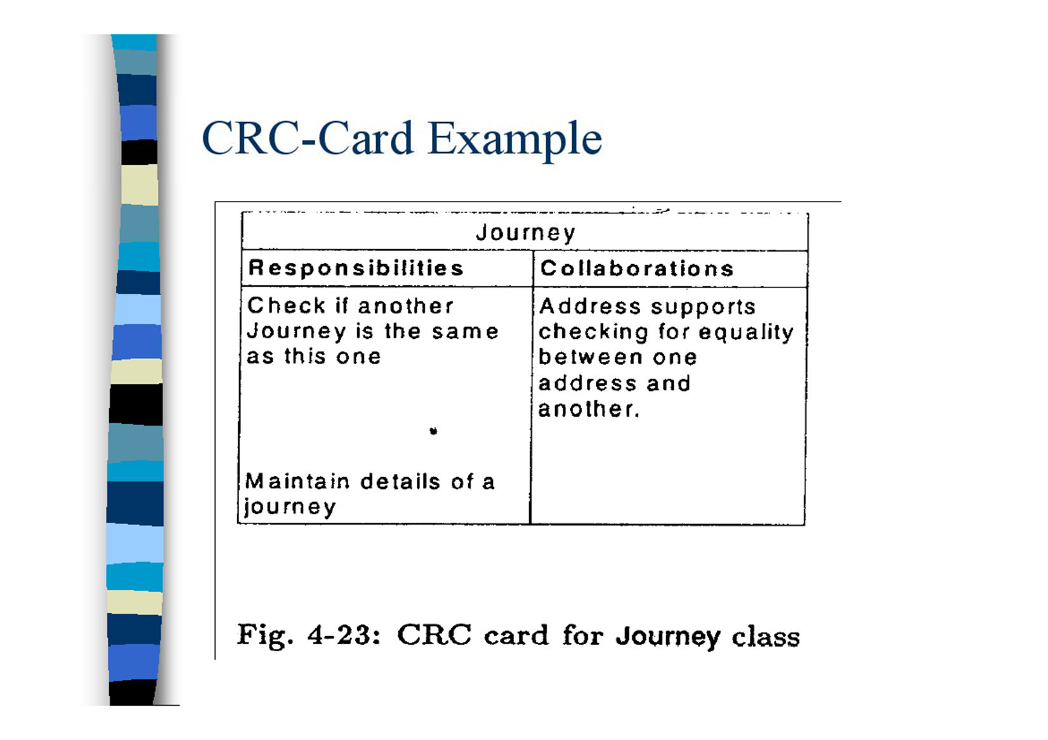
CRC-Card Example

Slide 10
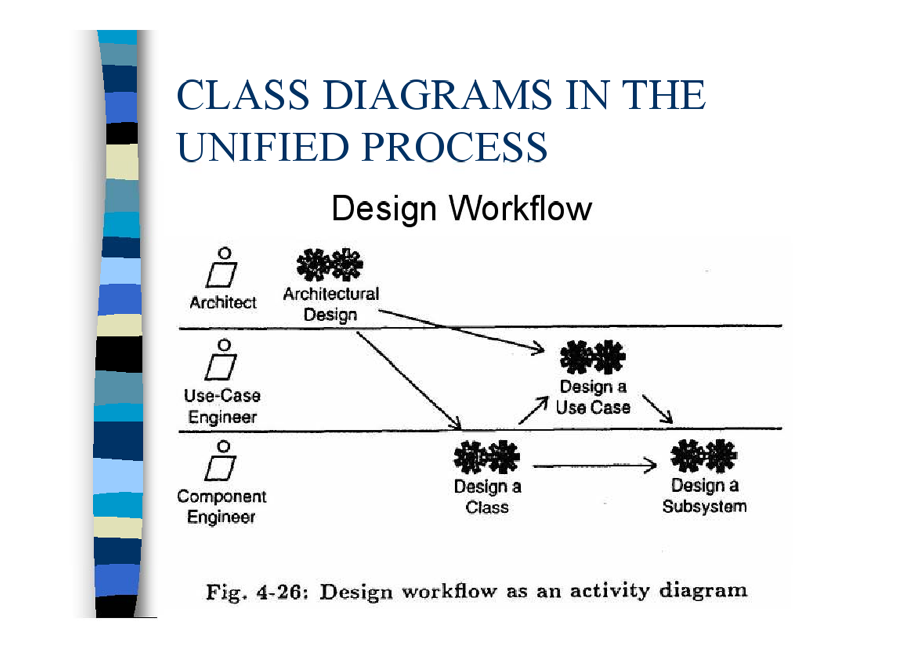
Class diagrams in the unified process

Slide 11
UML Class Diagrams

Slide 12
Representing UML Classes
Class Name
Attributes
Operations

Slide 13
Representing UML Classes
It is acceptable to show a class as :
a class name only;
a class name and a list of attributes;
a class name and a list of operations;
a class name, a list of attributes and a list of operations

Slide 14
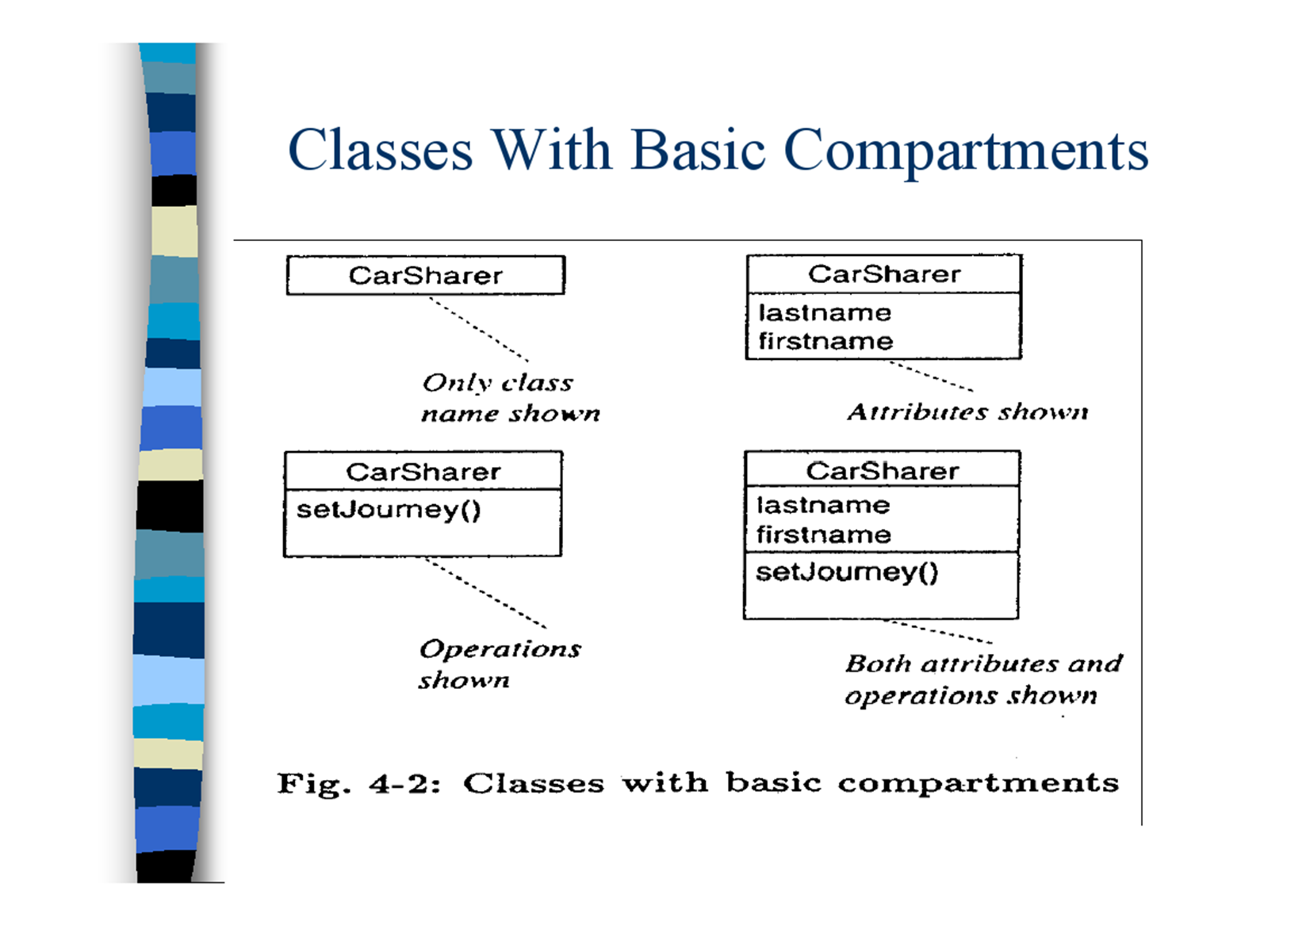
Classes With Basic Compartments

Slide 15
Class Properties
The class properties are listed in curly brackets, that is
{<property-list>}.
Class information with a Boolean (true/false) type, such as: isAbstract, is Leaf, and isRoot
– {is Abstract=false} is the assumed status if the isAbstract property is omitted
The isRoot property can be used to specify whether or not, a class may be a specialization of another class
{isRoot=true} or isRoot means that a class may not be a specialization (or subtype) of another class

Slide 16
Naming Classes
Class names should be singular nouns
Class names should come directly from the problem domain

Slide 17
Naming Conventions
Example
The UML uses "Camel Notation
Class names begin with capital letters
Attribute and behavior names begin with lower case letters
Second and subsequent words in compound names are capitalized
Spaces may appear in UML names but not in program code
Java style also specifies Camel Notation
Aircraft Simulator
Altitude
compassHeading airSpeed
monitorAirSpeed() monitorAltitude() setHeading()

Slide 18
Attributes and Operations
Both attribute, and operations are listed, one per line, in the appropriate compartment .
Each attribute and operation name should start with a lowercase letter

Slide 19
Attributes Describe an object
Characterize or distinguish an object
Are a data values (variables) held by objects .
Are the data an object is responsible for maintaining
Are often nouns associated with the object
Should be placed at the highest level in an inheritance hierarchy where they remain applicable to each descendant
"Good" attributes depend on what is being modeled
Derived attributes are determined from the values of other attributes (may be implemented as an operation)

Slide 20
Behaviors Operations Services, Member Functions or Methods
A transformation that may be applied to or by an object
Behaviors, operations, and services (synonyms) are
Member functions and methods (language specific) are
The physical implementation of behaviors, operations, services
Called through an object; that object is an implicit target
Polymorphic operations may be applied to many classes and are implemented through multiple functions or methods

Slide 21
Classifying Methods
Standard methods
Add a new object
Show information about an object
Delete an object
Change the values of attributes of an object
Database synonyms: add, query, delete, and update
Custom methods
Tailored for a specific class
Reflect the responsibilities of an object
Are the special services provided by an object
Focus on custom methods during analysis, add standard methods during design and implementation

Slide 22
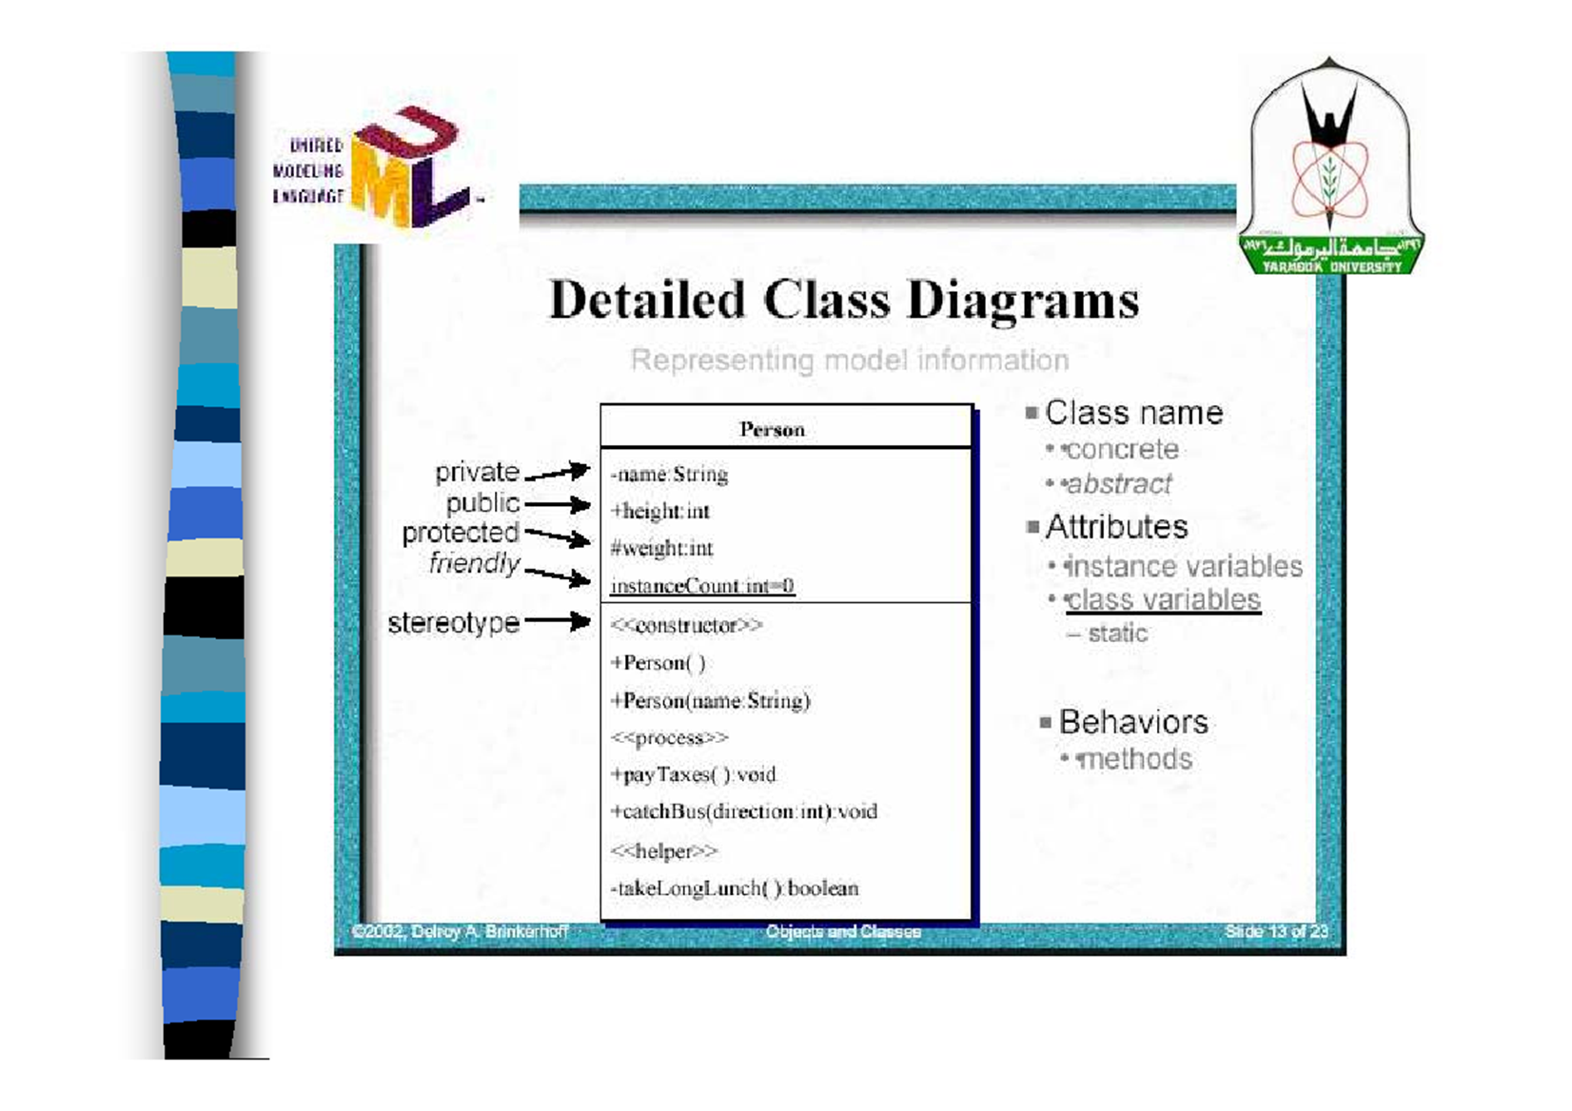
Detailed Class Diagrams

Slide 23
Attribute and Operation Visibility
Attributes and operations can be assigned a level of visibility shown on the class diagram with a visibility indicator
The visibility of a feature can be defined by either a keyword or a symbol
private (with the symbol -),
public (+),
or protected (#)

Slide 24
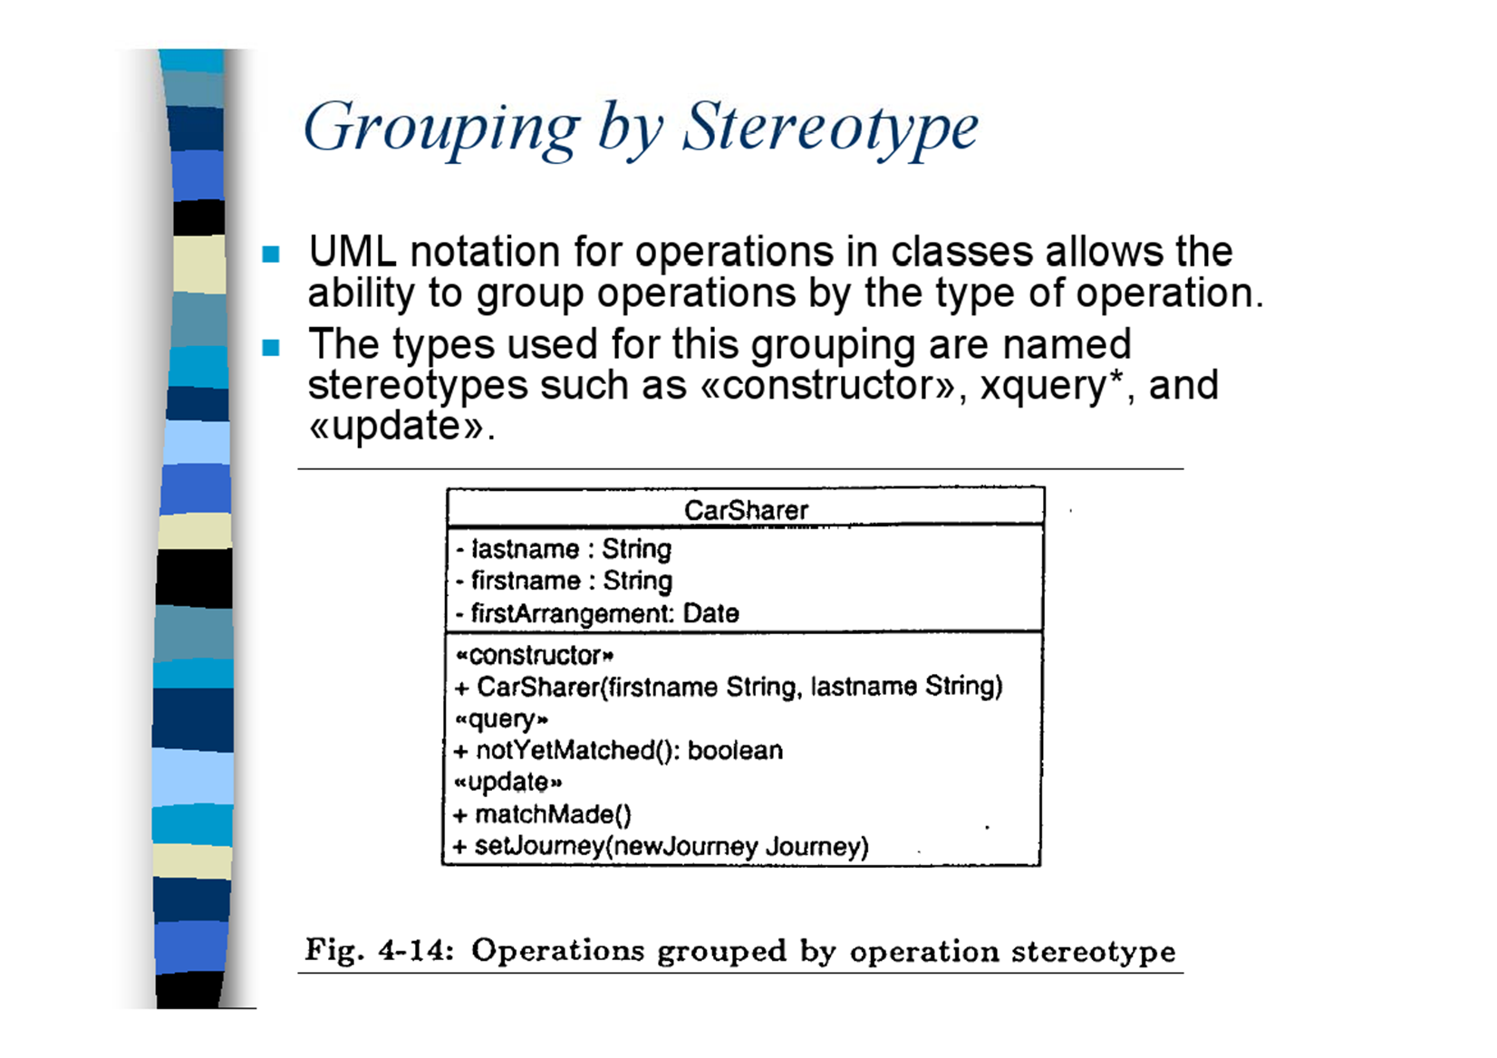
Grouping by Stereotype
UML notation for operations in classes allows the ability to group operations by the type of operation.
The types used for this grouping are named stereotypes such as «constructor», *query*, and «update».

Slide 25
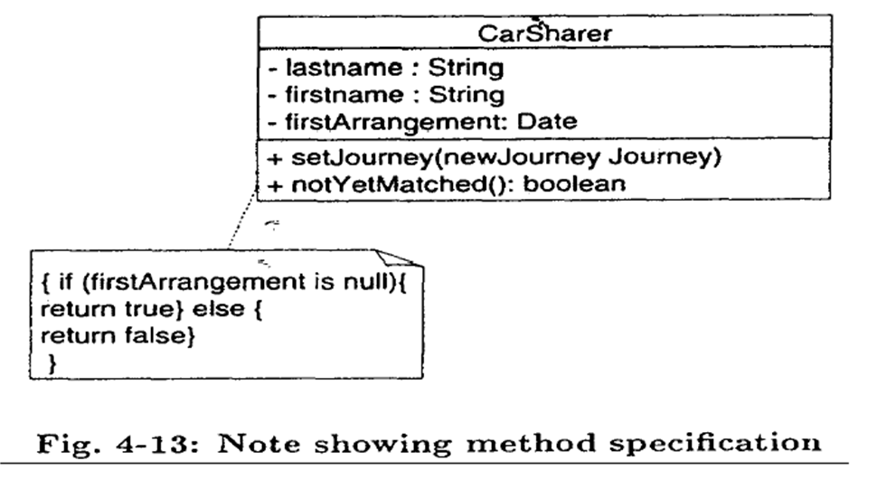
Method Note
The specification of a method body for an operation may be included as a note attached to an operation on the class diagram .
It is important to note that the method note does not specify how the method should be implemented

Slide 26
Associations
An object-oriented system is built from class types that collaborate with each other by passing messages and receiving responses
Where instances of one class pass messages to instances of another class, an association is implied between those "two classes.

Slide 27
Class Associations
Represent relationships between instance of classes
Person owns a car
class
class
Association

Slide 28
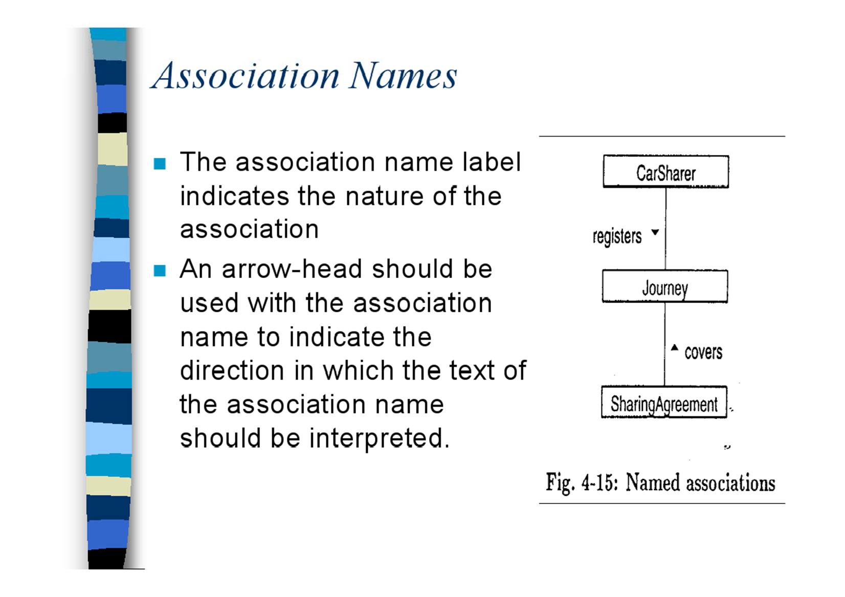
Association Names
The association name label indicates the nature of the association
An arrow-head should be used with the association name to indicate the direction in which the text of the association name should be interpreted.

Slide 29
Multiplicity
1 (exactly one)
n (where n is a single number)
* (the range 0 to infinity)
1..* (the range 1 to infinity)
n1 ... 12 (where n1 and n2 are single numbers forming a range)
0..1 (zero or one)

Slide 30
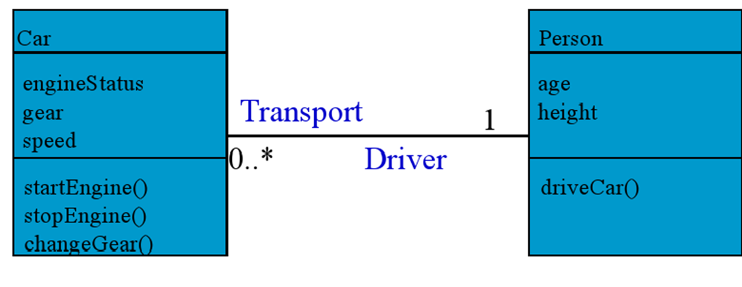
Multiplicity Example
One Person associates with zero, one or many cars

Slide 31
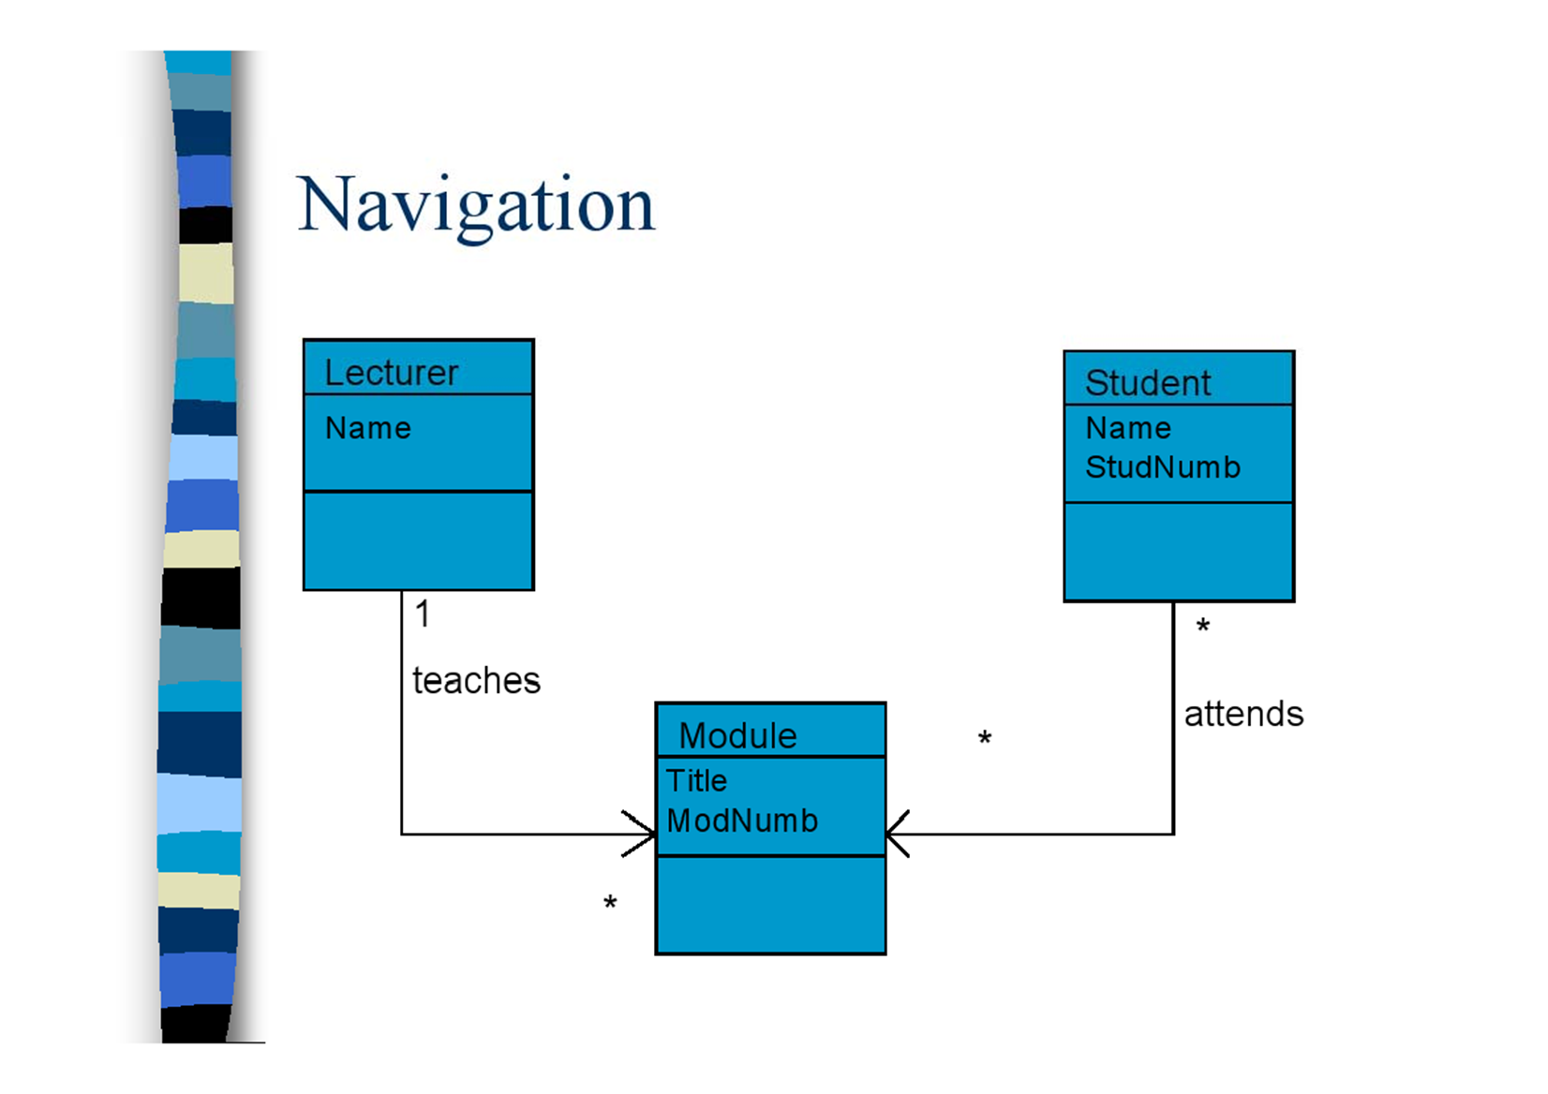
Navigation

Slide 32
Whole-Part Association
Associations are sometimes created where the name of the association is something lik
consists of or is made up of
While there is clearly an association between the classes, it is desirable to be able to express the more subtle semantic
objects of this class consist of objects of that class'

Slide 33
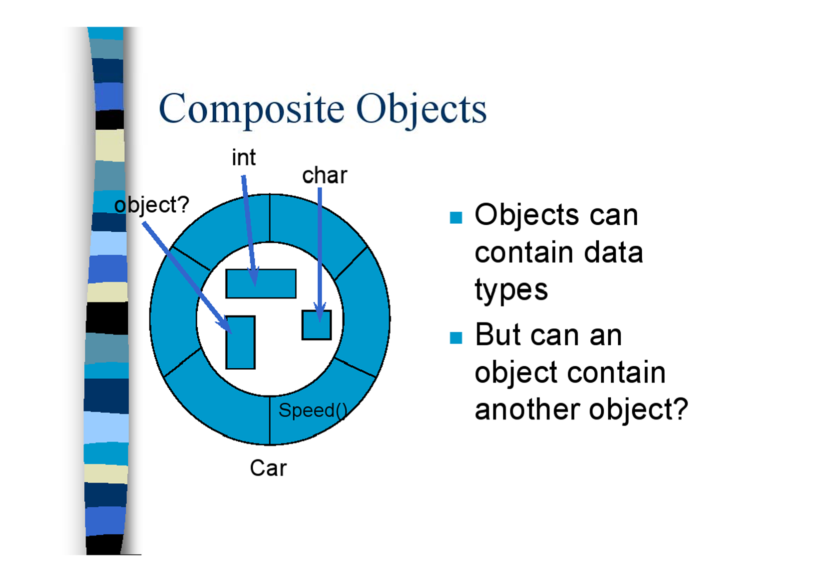
Composite Objects
Objects can contain data types
But can an object contain another object?

Slide 34
Class Relationships
OO features (generalization / specialization, also known as inheritance)
Structural (whole / part)
• Association
• Aggregation
• Composition

Slide 35
Aggregation and Composition
There are two special kinds of association that are part of the class diagram notation:
The aggregation association
The composition association
The general concept of aggregation is often referred to as being a whole-part or part of relationship. One class is a part of another class

Slide 36
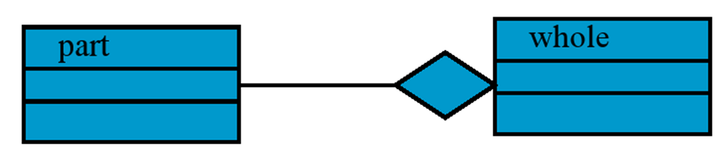
Aggregation
Objects can be made up of other objects, e.g. a car is made up of engine, body, transmission and wheels.
Aggregation hierarchies are used to describe this
There is no inheritance in an aggregation hierarchy
We use a special relationship to indicate aggregation

Slide 37
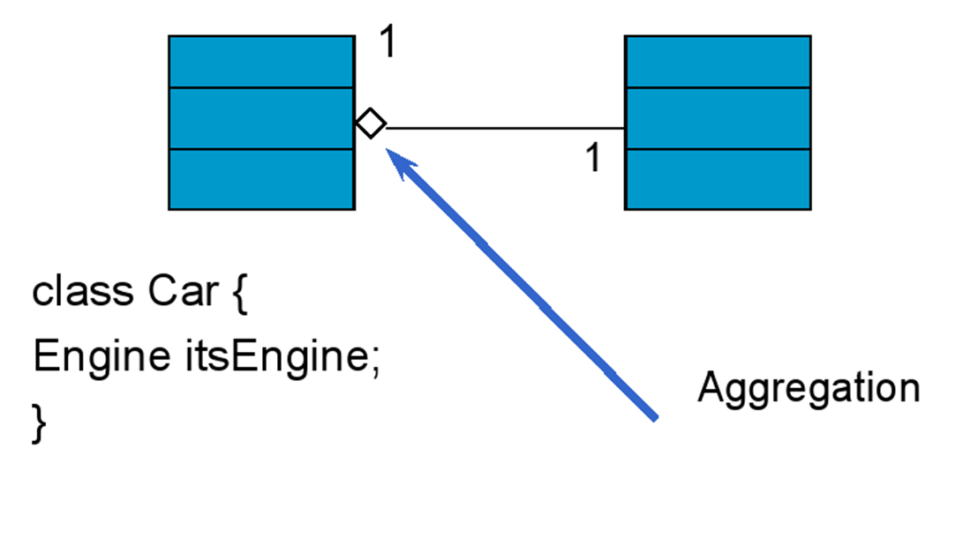
Aggregation - example

Slide 38
2. Composition
A composition association implies coincident lifetime
A coincident lifetime means that when the whole end of the association is created, then the part components are also created
When the whole end is deleted, the part components are also deleted
In composition a part cannot exist without being part of a whole.

Slide 39
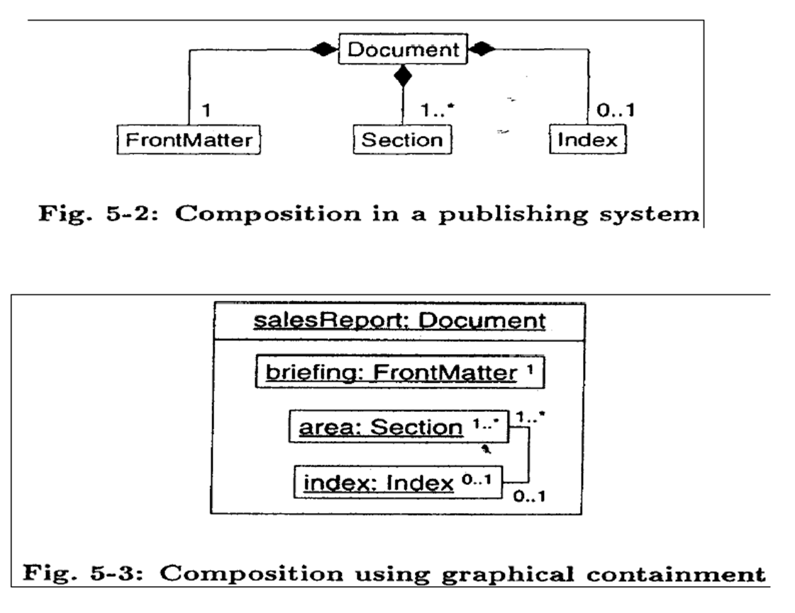
Example of Composition

Slide 40
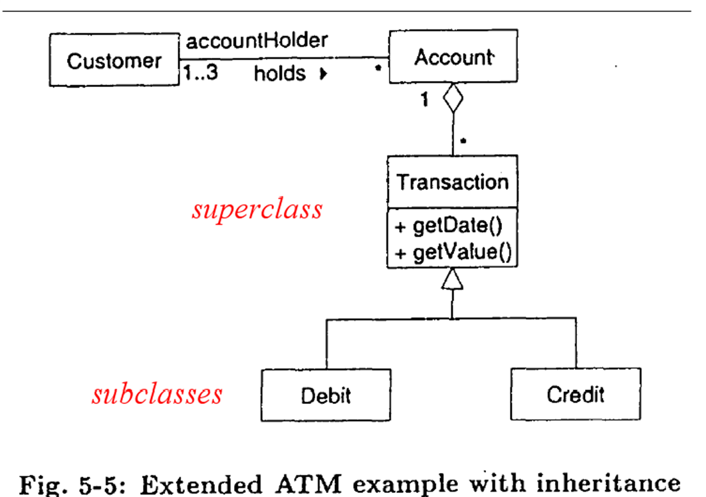
Example of Generalization

Slide 41
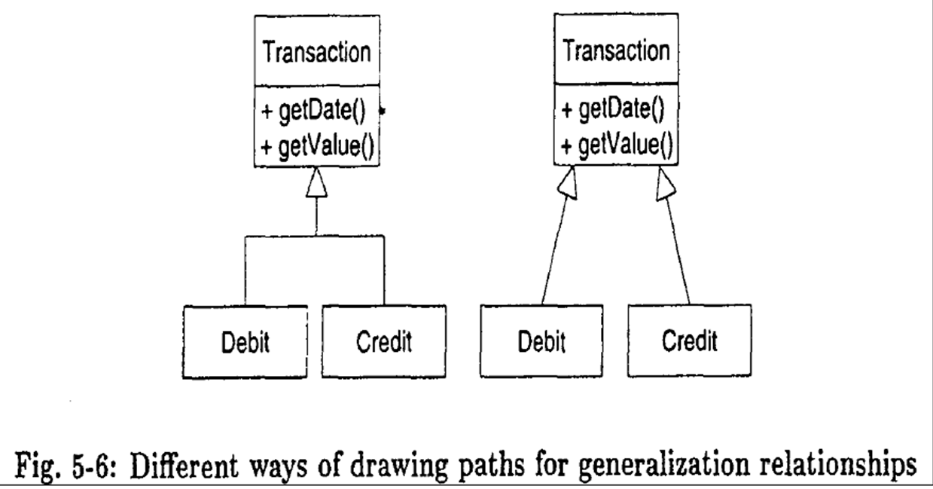
Generalization

Slide 42
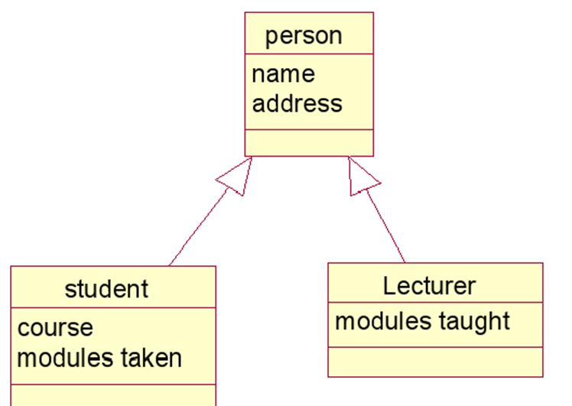
Inheritance - example

Slide 43
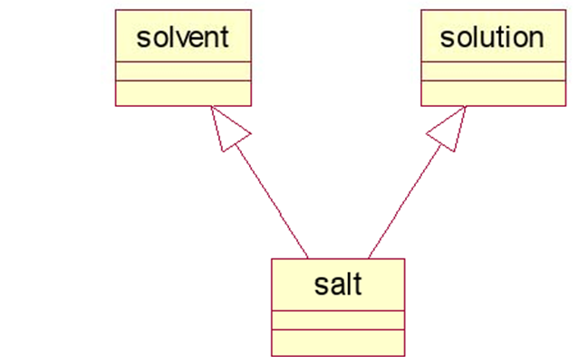
Multiple inheritance
An object can get operations and attributes from two or more other objects (not supported by VB)

Slide 44
Generalization Annotations
Generalization structures can be annotated with both constraints and discriminators
Constraints can be used in generalization structures where subclasses of the generalization are subject to certain semantic condition
Discriminators can be thought of as role names for generalizations, either clarifying the semantics of the generalization or allowing multiple generalizations from one superclass

Slide 45
Constraints
Generalization constraints can be either predefined or user-defined
The constraint itself is shown in curly braces ({ ... })
Where a shared path generalization is used, the constraint can be placed next to the superclass end of the generalization, near the triangular arrowhead

Slide 46
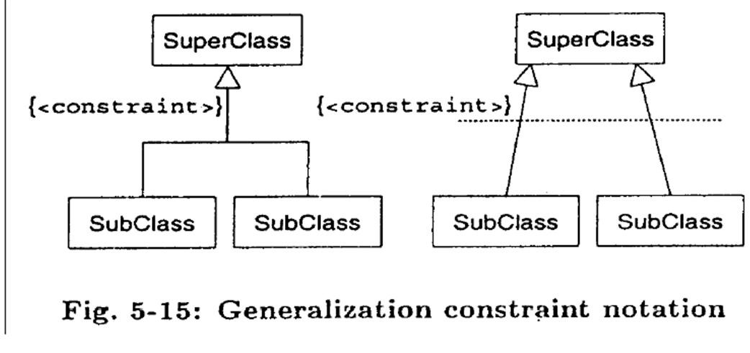
Example of Generalization Constraint

Slide 47
Constraints
UML has predefined the following four common constraints
Incomplete,
Complete,
Disjoint
Overlapping

Slide 48
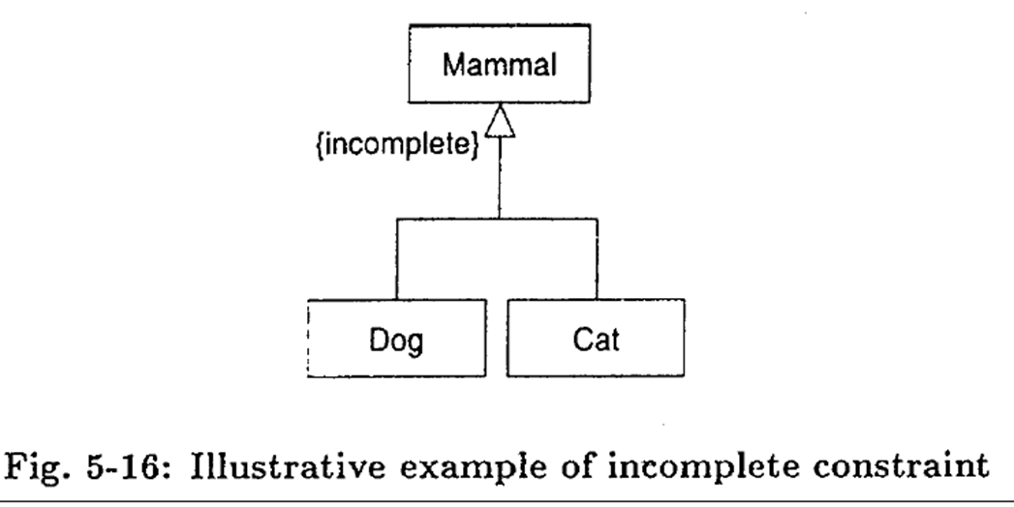
Incomplete Constraints
The incomplete constraint indicates that whilst some of the subclasses may have been specified, it is known that not all subclasses that exist in the problem domain have been specified

Slide 49
Complete Constraints
The complete constraint specifies that all the subclasses in that generalization have been defined within the class model.
Remember though that not all those subclasses may be shown on one class diagram.

